Slide 1
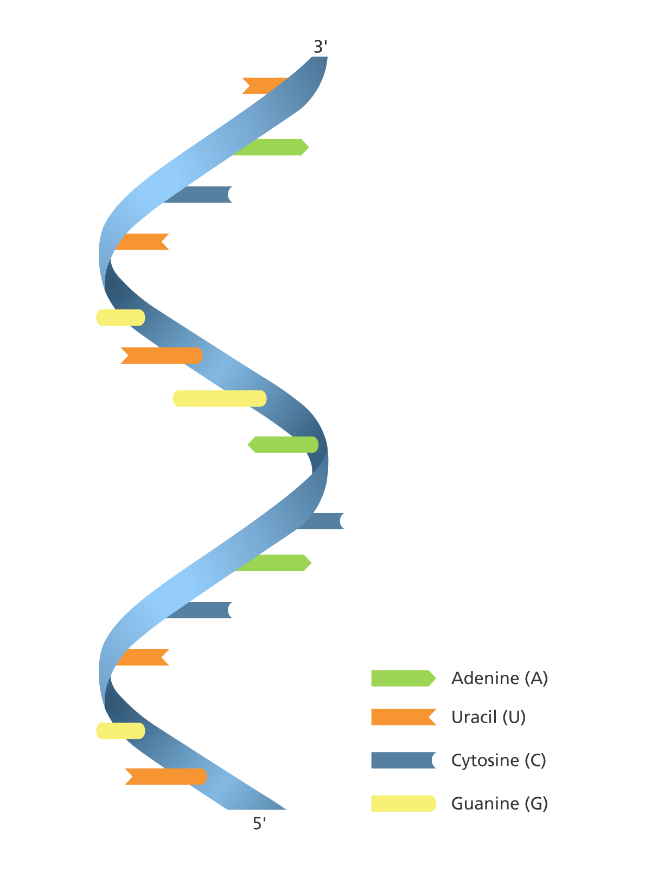


RNA- Seq De novo Assembly using Trinity
Paula Sliva (12122187)
Computational biotechnology

Slide 2


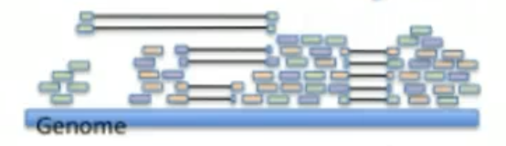


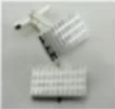
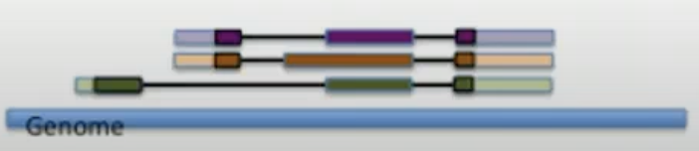
Contemporary strategies for transcript reconstruction from RNA- Seq
RNA-Seq
Typically 100 base length reads
Spliced alignment of RNA-Seq to genome
De novo transcript assembly
Tophat
Transcript reconstruction from RNA-Seq spliced alignments
Transcript reconstruction from spliced alignment of assembled transcripts to genome
Cufflinks

Slide 3


Developed at the Broad Institute and the Hebrew University of Jerusalem
Method for the efficient and robust de novo reconstruction of transcriptomes from RNA-seq data

Slide 4
Independent software modules
Inchworm assembles the RNA-seq data into the unique sequences of transcripts, often generating full-length transcripts for a dominant isoform, but then reports just the unique portions of alternatively spliced transcripts.
Chrysalis clusters the Inchworm contigs into clusters and constructs complete de Bruijn graphs for each cluster. Each cluster represents the full transcriptional complexity for a given gene (or sets of genes that share sequences in common). Chrysalis then partitions the full read set among these disjoint graphs.
Butterfly then processes the individual graphs in parallel, tracing the paths that reads and pairs of reads take within the graph, ultimately reporting full-length transcripts for alternatively spliced isoforms, and teasing apart transcripts that corresponds to paralogous genes.

Slide 5
Hardware requirements
Linux
1G RAM per 1 M Ilumina reads
Typical data sets involve 20M to 100 M paired-end 76 base reads
1G storage per 1M Ilumina reads

Slide 6
Running Trinity
Trinity.pl --seqType fq \
--JM 20G \
--left reads_1.fq –right reads_2.fq \
--CPU 6
FASTQ file format
Trinity output: single FASTA file containing all transcript sequence
Lower limit of RAM to allocate
Paired-end reads filenames
Maximum number of parallel processes

